Slide 1

Automate your job like a pro so you can go do other things and your boss won’t know and everyone will think you’re some sort of super employee and you can spend your whole day watching Rockies highlights and chatting with the GIS staff and playing corn hole and taking like a dozen bathroom breaks and constantly trying to find your lost coffee mug and still get more done than those other employees who don’t know Python..

Slide 2
This CLASs
Outline:
Introduction – What, Why, Who, Where, When, How
Basics – python files, syntax, assignment, imports
Data types –numbers, strings, lists, and dictionaries
Flow control – conditions and logic
Functions – reusable code
Program development
Course content, code samples, and tools
Notebook Viewer

Slide 3

What is python?
These guys are awesome!

Slide 4
What is Python?
Python is a general purpose, high-level, object-oriented, dynamically-typed, interpreted programming language…
Blah, blah, blah..
These features are important, but not right now..

Slide 5
What is Python?
It’s a programming language - duh
Its open source (free)
It’s everywhere
It’s powerful
It has a huge user community and a ton of libraries
Its not named after the snake, it’s named after Monty Python!

Slide 6
What is Python?
It’s a general purpose problem solving tool.
If you solve your problem in a general-enough way, you’ve solved an entire class of problems for good. Good code is reusable (that’s kind of the whole point) !!
It’s a sandbox for exploring new domains.
As of 2019-08-17, there are over 190,000 packages on PyPi
https://pypi.org/

Slide 7
What is python (which)?
There are actually two Pythons..
Python 2.x
Comes with installs of ArcMap
Will be deprecated in January 2020
Python 3.x
Comes with installs of ArcPro
Not backward compatible with Python 2.x
Most recent version is 3.7.4 (July 8, 2019)
More on this later..

Slide 8
Why Python?
Powerful
Easy to learn (for a programming language)
Think of it like learning a foreign language:
Grammar, syntax, sentence (expression) structure..
Emphasizes code simplicity and readability:
Code is read FAR more than it is written.
Readability counts!

Slide 9
Why Python?
E.g. a function to print ‘Hello World’ to the console:
Java:
public class PrintHelloWorld {
public static void main(String[] args) {
System.out.print("Hello World !");
}
}
Python:
def PrintHelloWorld():
print ‘Hello World’

Slide 10
Why Python?
Data science
Scientific and mathematical computing
Web development
Finance and trading
System automation and administration
Security and penetration testing
Mapping and geography (GIS software)
Etc..
One of the most in demand programming languages.
If not the most outright

Slide 11
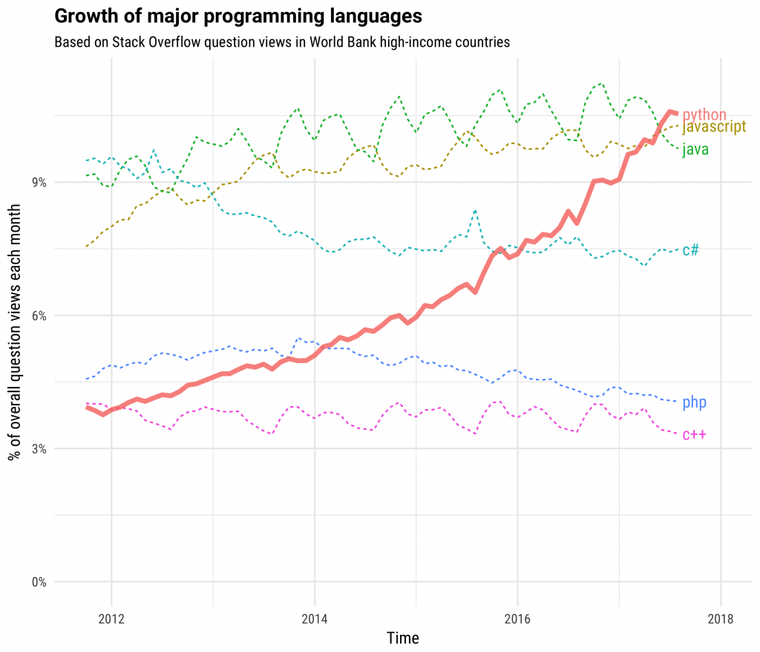

Slide 12
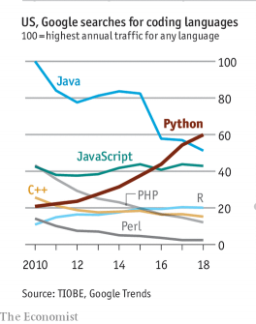

Slide 13
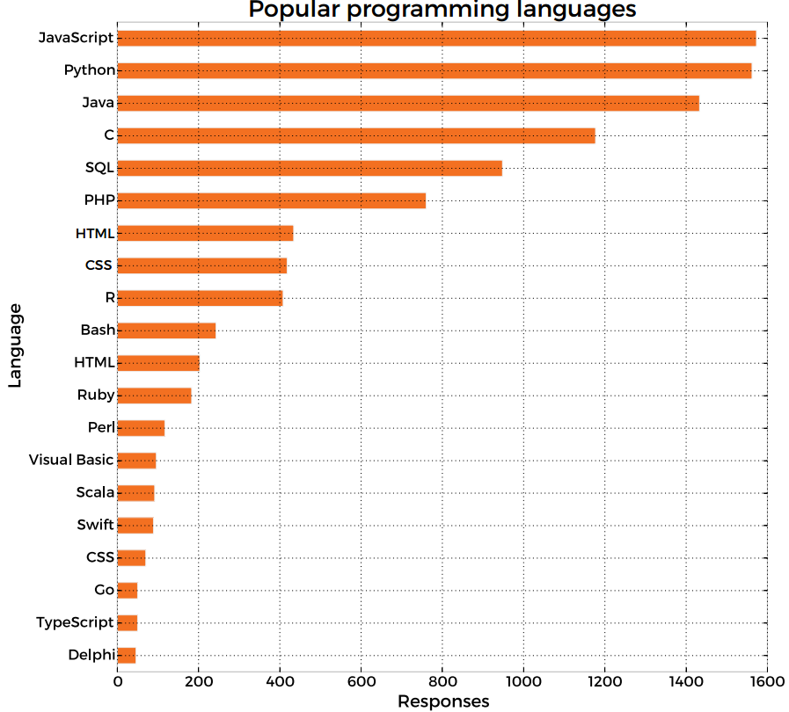

Slide 14
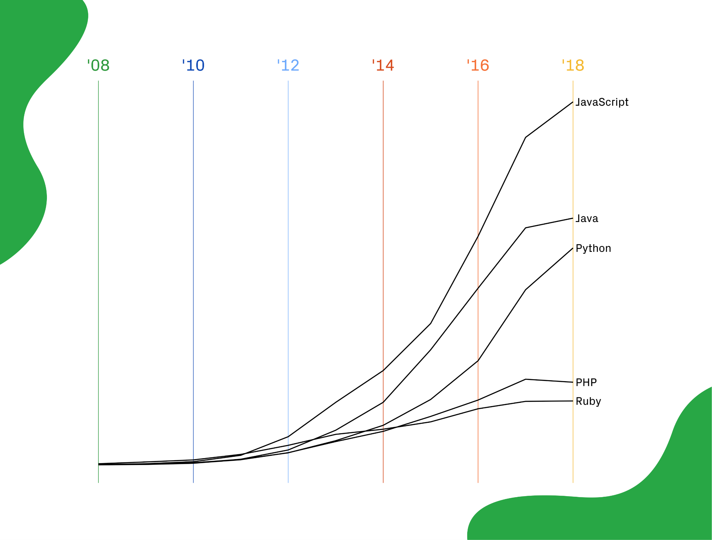
GitHub Repositories?

Slide 15
Who uses Python?
ArcGIS – in a big way!
And all the open source alternatives for that matter.
Google, YouTube, Netflix, Dropbox, Instagram, Spotify, Reddit, Pinterest, Etsy, Yelp, NASA, the CIA, Uber, Lyft, Chase, PayPal, Spotify, Amazon, Facebook, Yahoo…
And on and on and on and on and on..
Google founders:
“Python where we can, C++ where we must.”

Slide 16
When to Python?
When you have a clearly defined problem/workflow.
Often this is the hardest part..
When you have to do it redundantly.
It will take you longer to code a solution to a specific problem, than it will take you to just solve the problem..
Unless, you (or others) have to do it multiple times..
What is your ROI?
Avoid technical debt!

Slide 17
When not to Python?
When you need speed.
Python tends to be slower than compiled languages (C, C++, Java, etc).
In practice, you probably won’t notice.

Slide 18
where is Python?
Local install:
Either a pure Python Install:
https://www.python.org/downloads/
Or a purpose-built distribution:
https://www.anaconda.com/distribution
Network install:
Citrix: NOC > EGIS > EGIS Tools > NOC EGIS PythonWin27
Embedded within another program:
ArcMap and ArcPro – terminals and toolboxes

Slide 19
how to Python?
Interactive terminal
Input an expression, get an output
Stand-alone or embedded within another program
Command line
Interactive Development Environments (IDEs)
IDLE, Spyder, VSCode
Notebooks

Slide 20
Example: EGIS Server performance
We’ve all experienced slow network performance while using ArcMap resources via Citrix.
What is the baseline for understanding network performance?
What is considered bad performance?
Is there a particular culprit (server? time of day?)
cmd: ping -n 60 ILMOCOP3CT08-11

Slide 21
Example: Range Renewals
Calculate:
Acreage of allotment (BLM only)
Survey coverage (total acres, percent of allotment, list IDs)
Sites within allotment (sorted by eligible/not eligible)
Legal location PLSS
County
Quadrangle
Record:
Project ID, NEPA ID, and analysis results to a database
Determine if we need to revisit any sites (eligible)
Determine if we need to do additional inventory
Produce:
Report and maps detailing all the above

